Slide 1
The Hubble Space Telescope (HST) Advanced Camera for Surveys (ACS) Quicklook Application
Matthew Bourque
October 19, 2017

Slide 2
The Hubble Space Telescope (HST)
Something

Slide 3
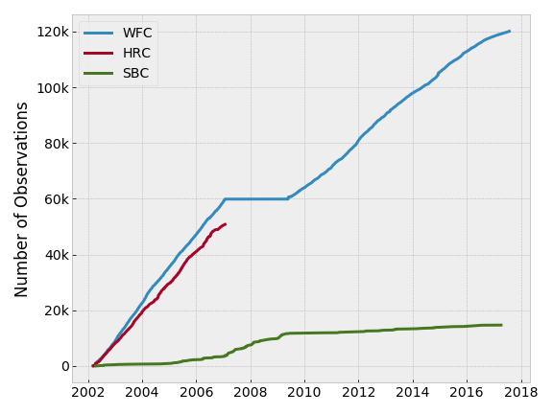
The Advanced Camera for Surveys (ACS)
Something

Slide 4
The HST/ACS Quicklook Application
Something

Slide 5
The HST/WFC3 Quicklook Application
Something

Slide 6

Data Structure: FITS Files
Something

Slide 7
Data Structure: FITS file headers
Something

Slide 8
Data Structure: ACS FITS filetypes
Something

Slide 9
Data Structure: Key Metadata
Something

Slide 10
Intended Users
Something

Slide 11
Motivation
Something

Slide 12
Motivation: Data Retrieval Latency
Something

Slide 13
Motivation: File I/O
Something

Slide 14
Motivation: Data Redundancy
Something

Slide 15
Motivation: Data Discovery
Something

Slide 16
Implementation: Version Control
Something

Slide 17
Implementation: Programming Standards
Something

Slide 18
Implementation: API Documentation
Something

Slide 19
Implementation: Filesystem
Something

Slide 20
Implementation: Database Schema
Something

Slide 21
Implementation: MySQL and SQLAlchemy
Something

Slide 22
Implementation: MySQL and SQLAlchemy
Something

Slide 23
Implementation: Data Ingestion Software
Something

Slide 24
Implementation: Logging
Something

Slide 25
Implementation: Web Application
Something

Slide 26
Implementation: acsql Package
Something

Slide 27
Web Application: Homepage
Something

Slide 28
Web Application: Database Query Page
Something

Slide 29
Web Application: Query Results
Something

Slide 30
Web Application: ACS Archive
Something

Slide 31
Web Application: View Proposal
Something

Slide 32
Web Application: View Image
Something

Slide 33
Deliverables
Something

Slide 34
Possible Enhancements and Extensions
Something

Slide 35
Possible Enhancements and Extensions
Something

Slide 36
Demo
Something

Slide 37
Acknowledgements
Something

Slide 38
Sample Chart Fonts/Colors
PROJECTS | LEADS | GOALS
Exoplanet Characterization Toolkit (ExoCTK) | N. Lewis & K. Stevenson | Developing seven open-source, modular data analysis packages focused on atmospheric characterization of exoplanets
Community Astronomy Software Initiative: STScI (CSI: STScI) | L. Strolger & E. Tollerud | Building and supporting an infrastructure to centralize and maintain python code for astronomical data analysis
Science Yield Optimization for Future Missions | J. Tumlinson | Developing interactive online tools for simulating astrophysics data collected from LUVOIR observations
Demonstrating Segmented-Telescope Coronagraphy by 2019 in Preparation for LUVOIR | R. Soummer | Lab astrophysics to advance technologies for coronagraph wavefront control for segmented space telescopes

